Slide 1
DATA MINING
Building (a part of) Watson
Bucur Răzvan
Muresan Vlad
Misan Maria-Teodora

Slide 2
Introduction
Objective → Create a simplified version of IBM Watson to compete at answering Jeopardy questions using Wikipedia as a primary information source
Challenge → Efficiently processing and searching through vast amounts of data to find relevant answers

Slide 3
Implementation Steps
Data Retrieval
Collected and indexed approximately 280,000 Wikipedia articles to serve as the knowledge base.
Pre-Processing with NLP
Applied NLP techniques, focusing on lemmatization, to normalize text data for better search performance.
Whoosh Indexing Process
Utilized Whoosh for creating a searchable index of pre-processed Wikipedia articles, enabling efficient information retrieval.

Slide 4
Advanced Query Processing
Initial Query Attempts → Started with raw queries directly derived from Jeopardy clues
NLP-Enhanced Queries → Improved query effectiveness by applying the same NLP preprocessing used before indexing, including lemmatization and TF-IDF incorporating the Jeopardy category in the query
Leveraged GPT to further enhance queries → in cases of initial failure or to provide additional context, ensuring higher relevance and accuracy

Slide 5
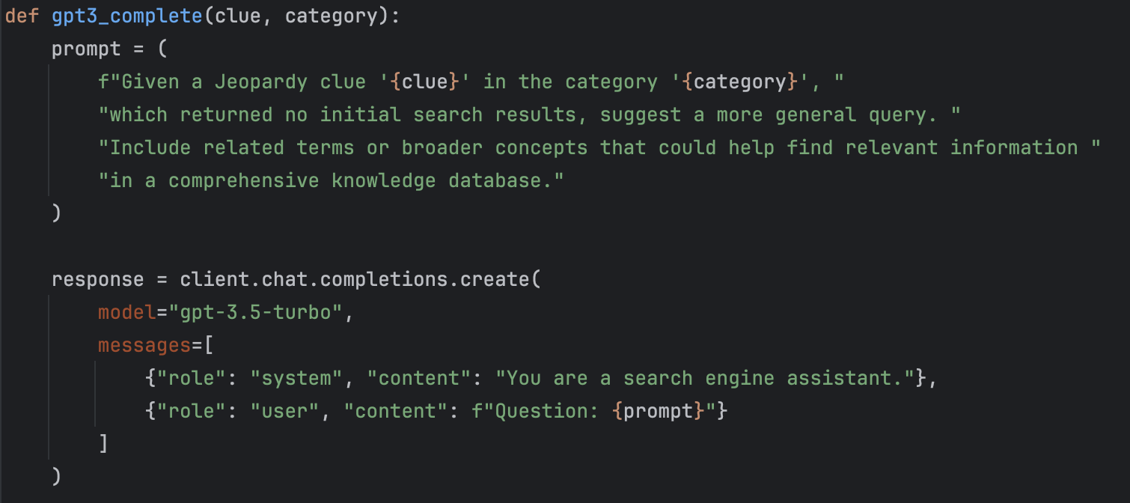
Results and Insights
!!! – Observed significant improvements in Precision@1 and Mean Reciprocal Rank (MRR) through iterative enhancements.
!!! – Integrating GPT for query enhancement and result re-ranking proved crucial for handling complex queries and improving answer accuracy.
Prompt engineering to enhance queries

Slide 6
Challenges and Solutions
??? Handling the vast volume of data efficiently
Implemented batch processing and parallel computing techniques for data pre-processing and indexing
??? Improving the relevance of search results
Applied advanced NLP techniques for query building and integrated GPT for dynamic query enhancement and result re-ranking
??? Dealing with no-result queries
Used GPT to reformulate queries, making them broader or more related to the initial clue, significantly reducing no-result instances

Slide 7
THANK YOU!

